Slide 1

Rent-a-Car Management Information System
JavaFX + MySQL MIS with external online request portal
Jawad Chahine
Programming 3

Slide 2
Project Overview
Desktop MIS
Core Modules
Dual Entry
A comprehensive desktop solution tailored for the operational needs of small car rental businesses.
Cars, Customers, Rentals
Maintenance, Users, Reports
Online Requests
JavaFX app for employees and a public website that feeds directly into the requests table.
Designed to be simple, efficient, and easy to maintain.

Slide 3
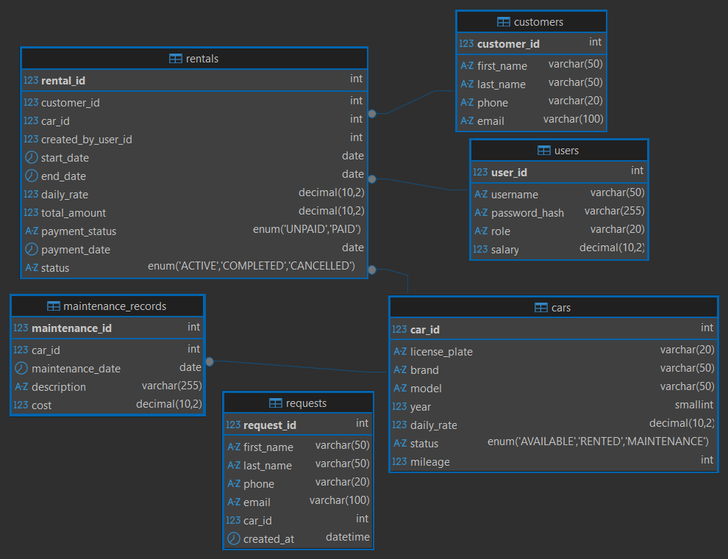
Database ER Diagram
Six Main Tables
`cars`, `customers`, `rentals`, `maintenance_records`, `users`, and `requests`.
External Integration
The `requests` table is populated directly by the external website for manual processing.
Relationships
Foreign keys link `rentals` and `maintenance` to other entities, ensuring data integrity.

Slide 4
System Architecture
Layered Flow
Views → Services → DAOs → MySQL
Session Management
Session stores login state; `DBconfig` manages the connection.
External Write
The public website writes directly to the `requests` table.

Slide 5
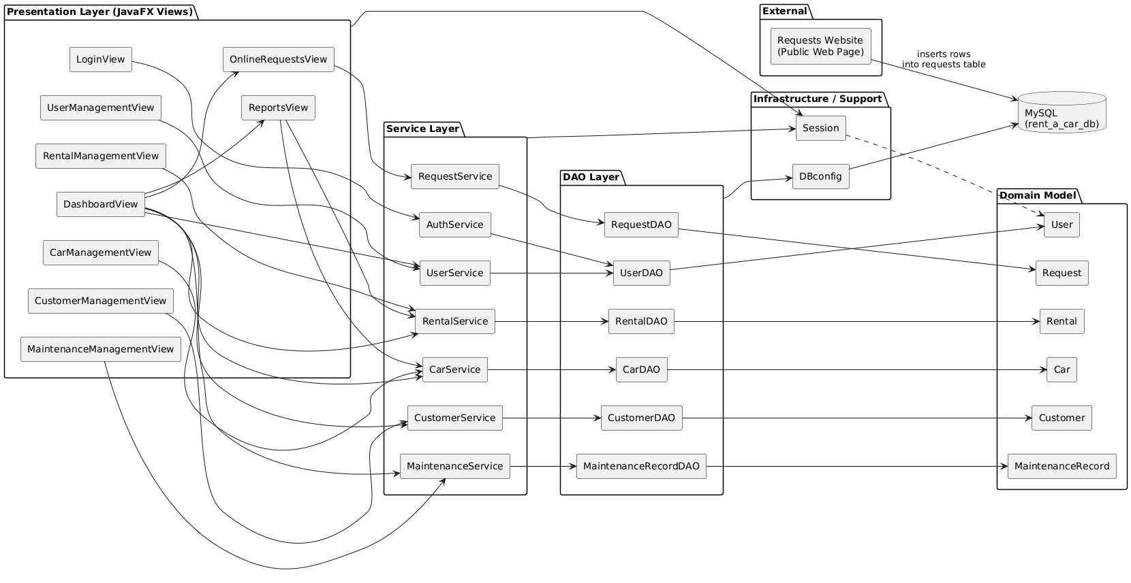
System Architecture

Slide 6
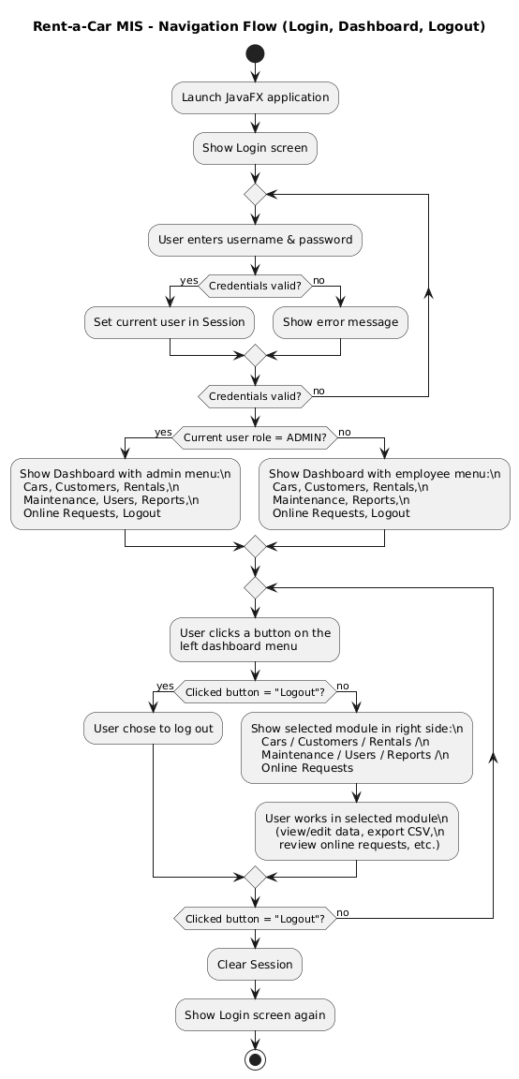
Navigation Flow
Login → Role-based Dashboard
Modules load in the center pane
Online Requests from external site
Logout clears session

Slide 7



Thank You
Jawad Chahine

